Slide 1
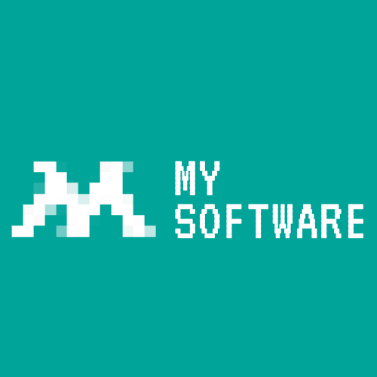
MY Software
Progress Update

Slide 2
Quick project recap!
MY Software aims to deliver a website that allows users to track mood and recommend articles based on user input as well as interact with a tamagotchi style game with various creatures.

Slide 3
What have we changed and developed?

Slide 4
We heard your ideas
Daily check in
Recommended articles based on keywords
Leads to help in crisis
Accessibility features
Text To Speech for articles

Slide 5
Where are we at now?

Slide 6
Some of our work

Slide 7
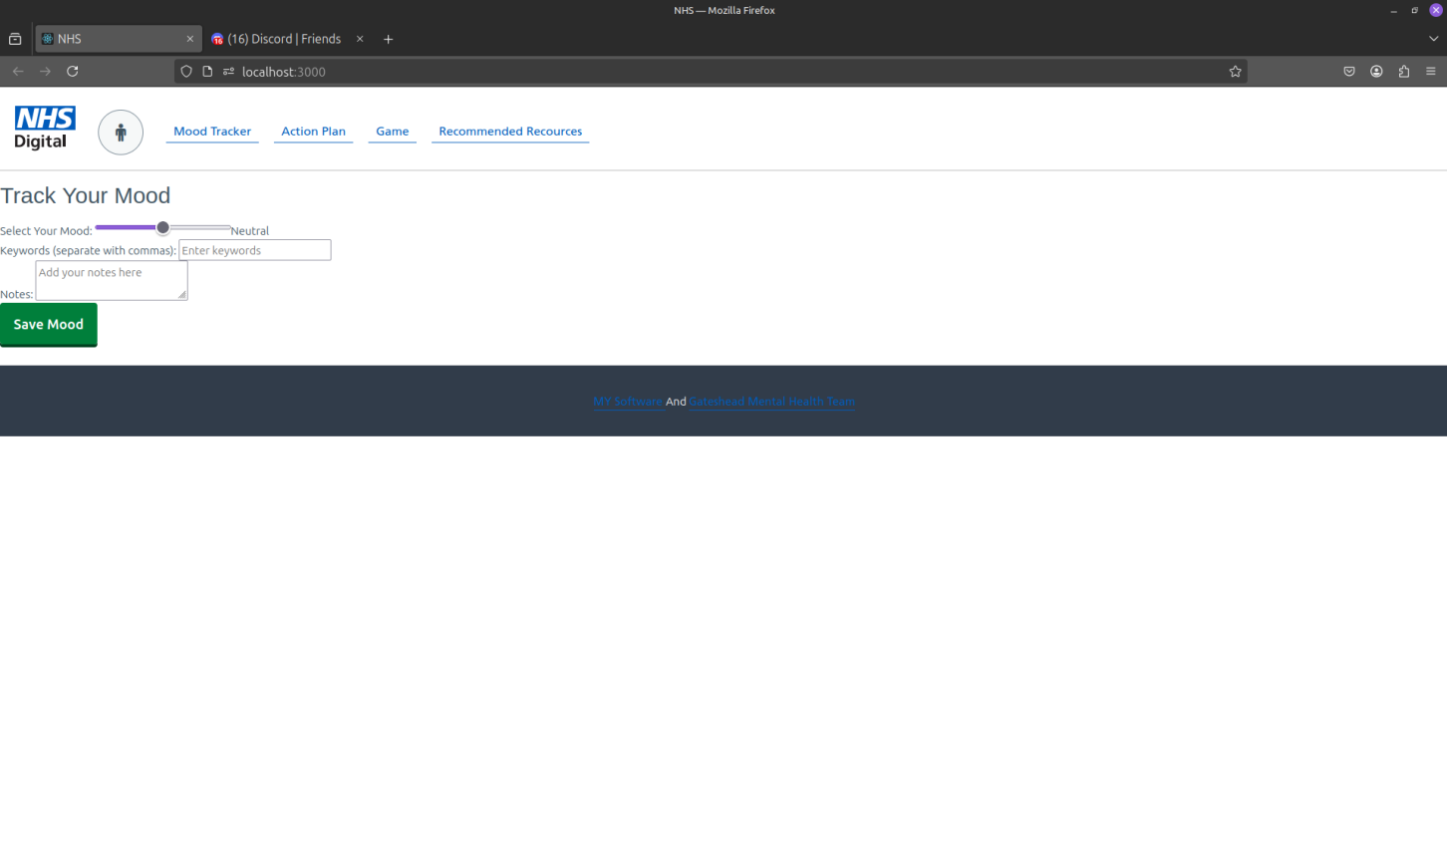

Slide 8
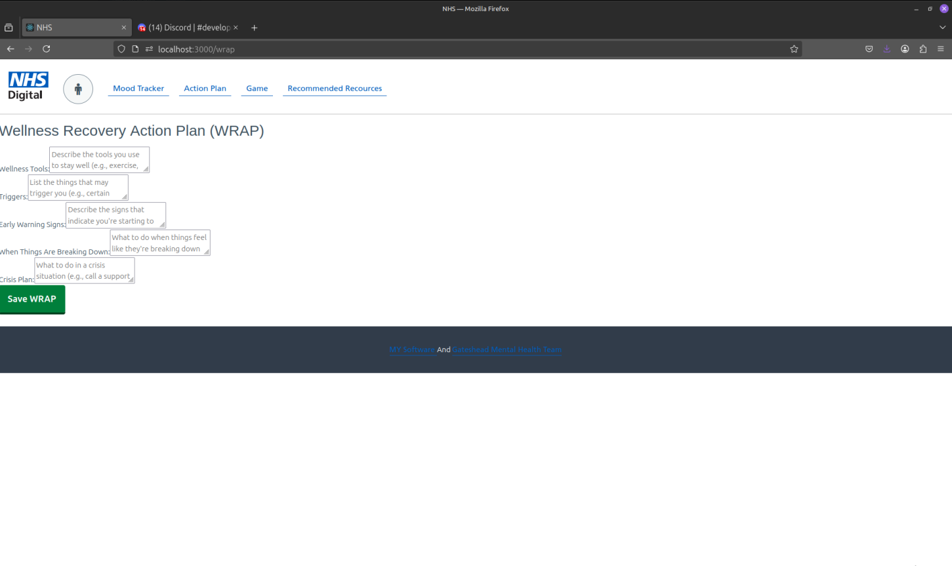

Slide 9
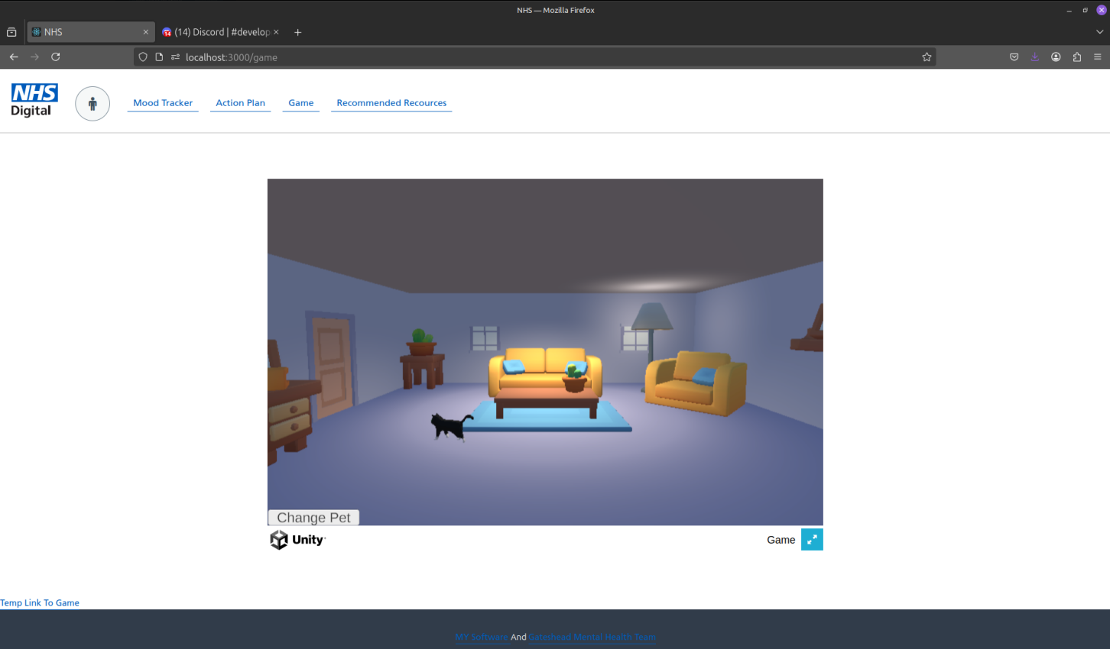

Slide 10
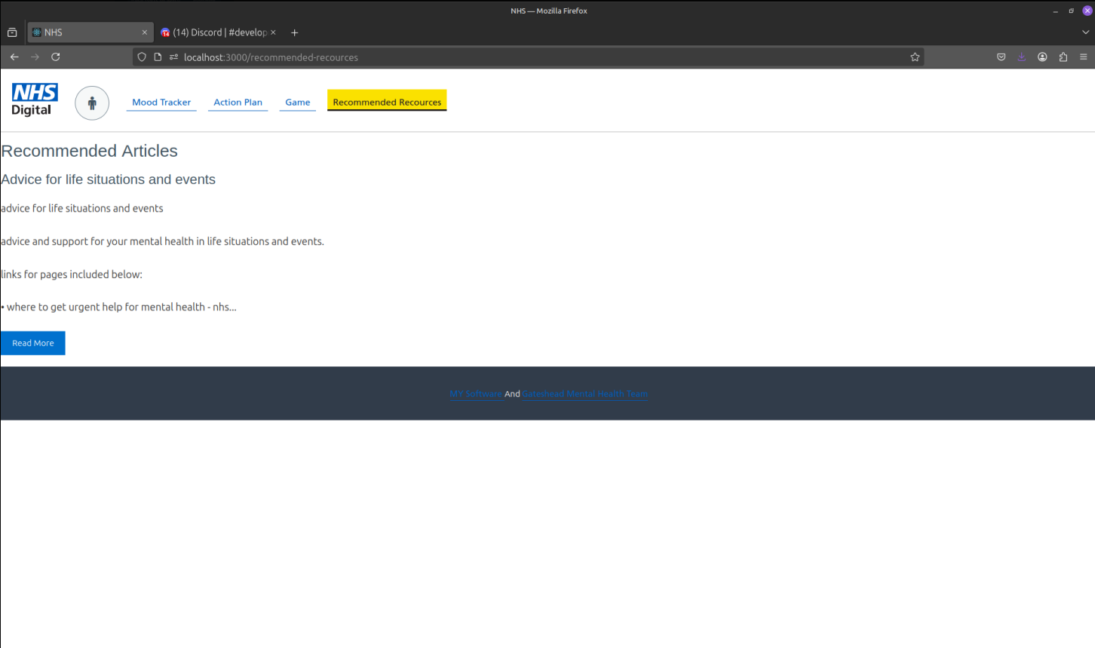

Slide 11
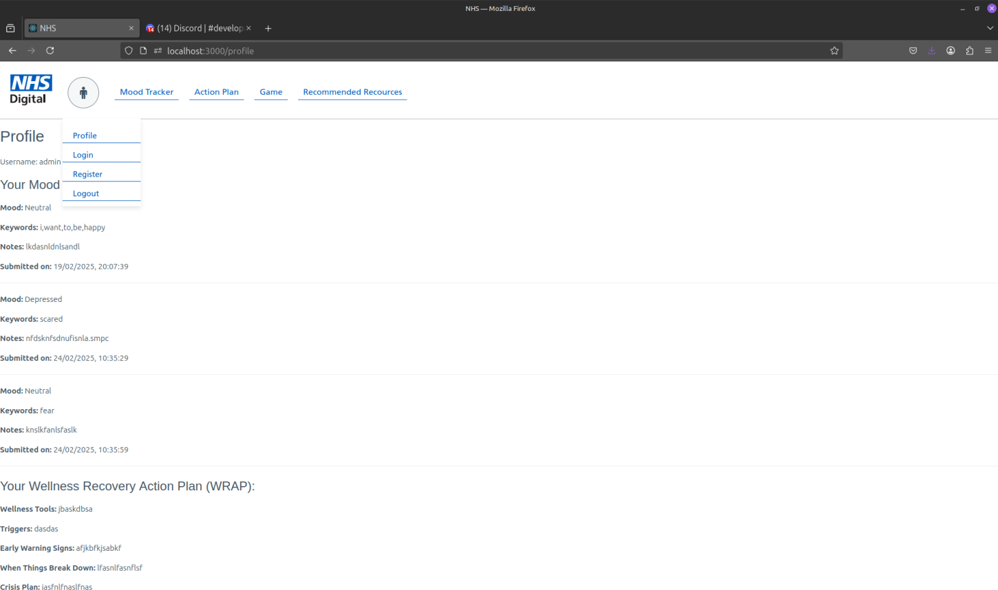

Slide 12
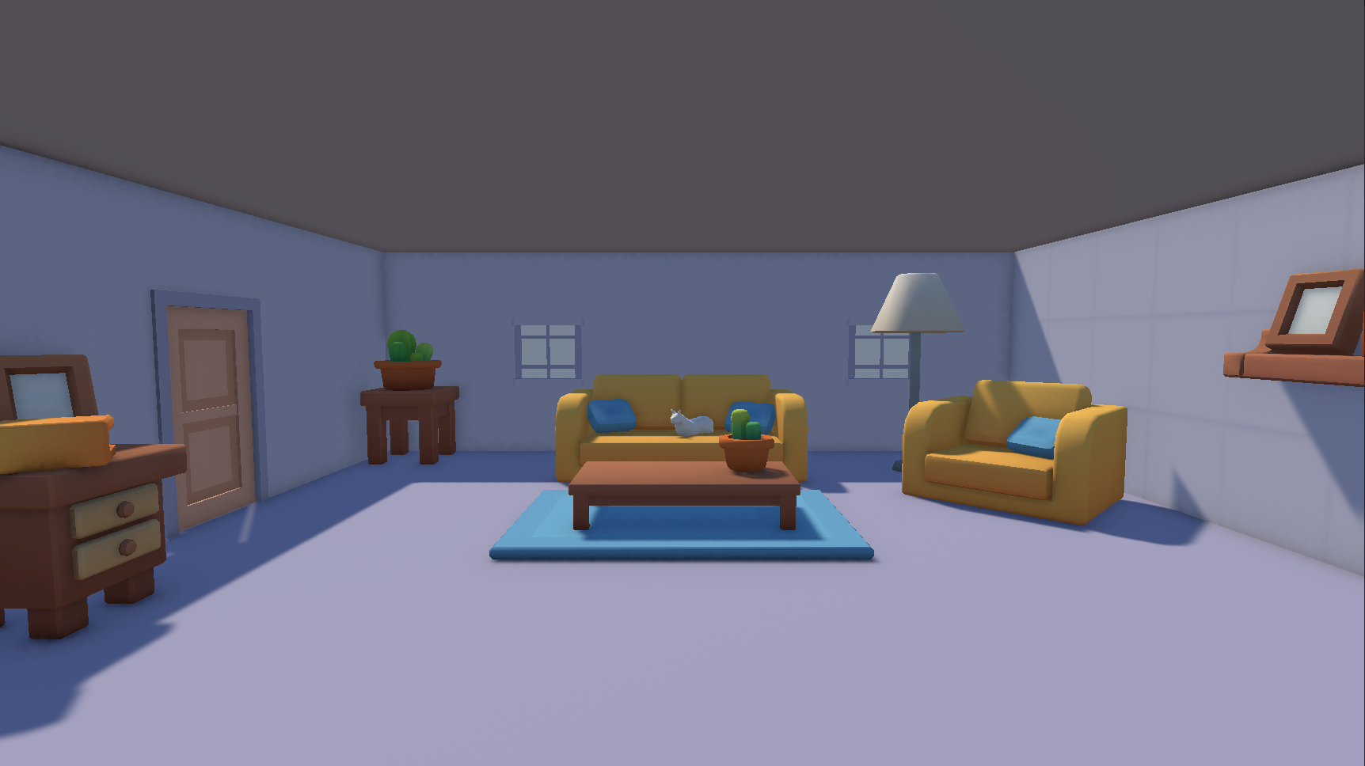

Slide 13
Our Prototype
This is the basic prototype we have developed using FIGMA.
Figma link
Notes:
Please describe the wireframe, Haythams job.

Slide 14
Now for

Slide 15
What are we planning?
We will work on our basic prototype.
Implement requested changes.
Continue to develop our website.

Slide 17
Any Questions

